Slide 1


3D Eye Tracking in Monocular and Binocular Conditions
Technische Universität Berlin
Xi Wang, Marianne Maertens, Marc Alexa
Notes:
Thank you Catrin for the nice introduction and welcome to my talk. I am a PhD student in computer graphics at TU Berlin and today I am going to talk about our work on 3D eye tracking.

Slide 2
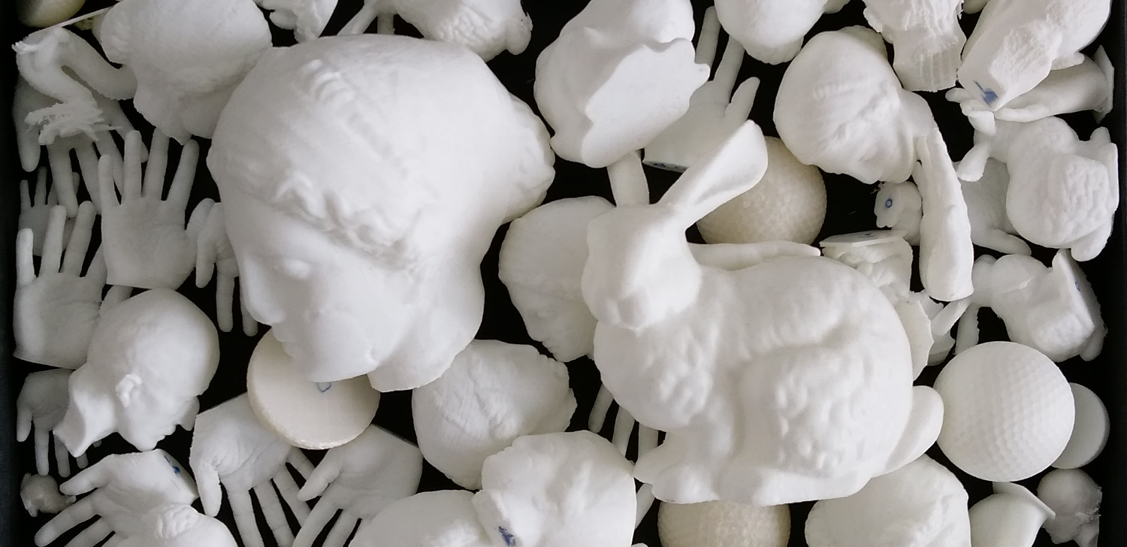
Motivation: eye tracking for 3D stimuli
Can we use vergence?
Notes:
Lets directly dive into the topic. In computer graphics we do a lot of 3D printing and would like to know where people look at on these printed 3D stimuli. One option is we take photos of the printed objects and ask observers to look at them on screen. But the problem is we don’t whether this will be the same if we give the object to observers and ask them to look at it while holding it in their hands for example.
For this purpose we would need to be able to track gaze positions in 3d. How do we do that? [CLICK]
The first idea would be to use vergence and estimate the gaze position in space by intersecting two eye rays.
But will that work, especially when we want to achieve certain accuracy at various distances.

Slide 3
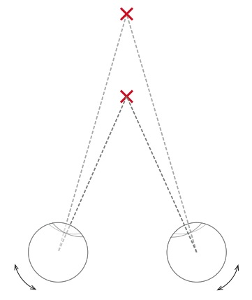
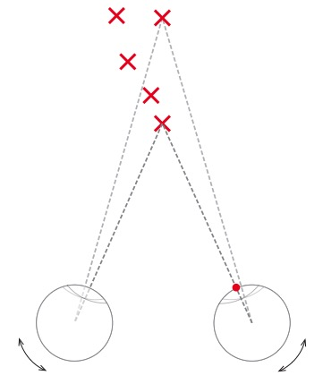
How does vergence work?
Rotation in different directions
Convergence angle & distance
?
straight lines = eyeball orientation
(pupil positions)
Notes:
Let’s first have a quick look at what we already know about vergence.
It is a type of slow eye movements that our eyes rotate in different directions until target object is projected in the center of fovea.
The angle of convergence correlates to the distance of the object. Near objects produce larger convergence angle than objects that are far away as we see in the figure.
Recall our idea is to use the intersection of two eye rays as the gaze position.
[CLICK]
The basic assumption here would be straight lines can be associated with eyeball orientation or pupil positions. But is it a plausible assumption, at least for the mathematical models?
[CLICK]
OK, Let’s formulate the question in another way. Given a fixed pupil position, can we model all corresponding 3d points with a straight line?
Interestingly this seems to be unquestioned so far.

Slide 4
Can eye rays be modeled as straight lines?
Notes:
Now our specific question is can eye rays be modeled as straight lines?
To answer this question, we need 3d eye tracking again because 2D experiment won’t tell us much.
Let me explain it with an example.
[CLICK]
Assume we are living in a world with one dimension less. Instead of rotating our eyes in 3D, we can only rotate it in a 2D plane. The 2D camera is reduced to a line as well as the monitor, which displays the targets.
[CLICK]
In the experiment, we ask our observer to fixate on the target and record his/her eye positions in the camera. One target corresponds to two pupil positions in the camera.
To simplify things, camera is modeled as parallel projection without any perspective changes here.
Just one side note, please be aware that straight lines in this type of illustration are used to indicate that light travels in straight lines in space.

Slide 5
Can eye rays be modeled as straight lines?
Notes:
We continue the procedure and show a few more targets on the screen.

Slide 6
Can eye rays be modeled as straight lines?
Target position
Eye position
Notes:
Once we have the corresponding point pairs, we can go ahead and estimate the mapping from the camera space to the monitor space.
Let’s denote the target position as y and use x for the pupil position.

Slide 7
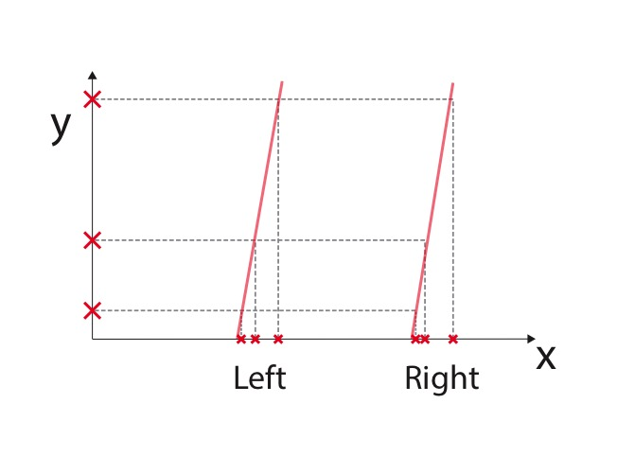
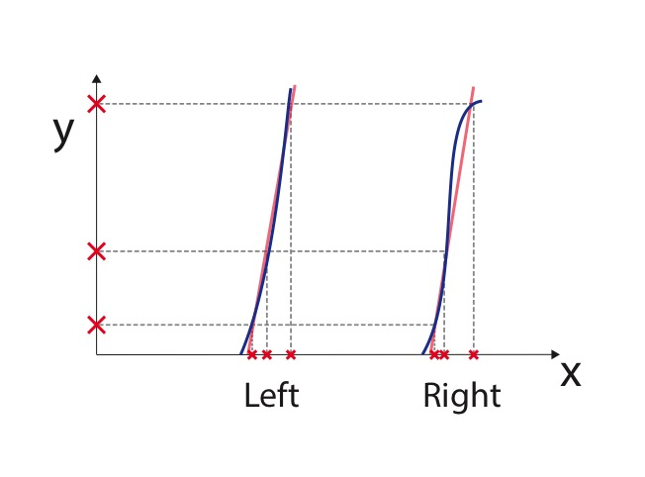
Can eye rays be modeled as straight lines?
Target position
Eye position
Notes:
First thing we do is to rotate the y axis to put things in a familiar format. Our goal is to model y as a function of x and estimate a mapping for each eye.
A simple linear mapping could be a starting point. But often it is not the case due to the distortion in the camera or other noise in the data.
In practice, a quadratic mapping is used to cope with the non-linearity of the system. Of course we can also collect more point pairs and model the functions with polynomials of higher degree.
But they all wouldn’t tell us about the geometry of eye rays in space. [CLICK]

Slide 8
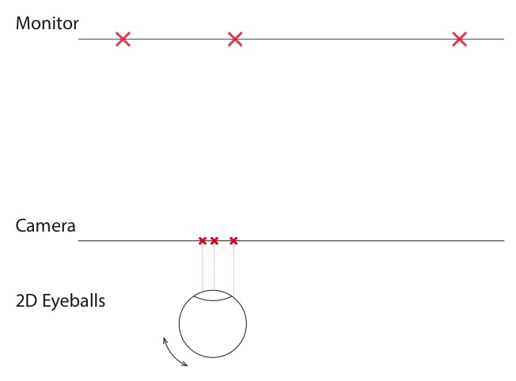
Can eye rays be modeled as straight lines?
Target position
Eye position
Notes:
What do I mean with geometry? Let’s go back to our initial setup.
Since we estimate a mapping for each eye independently, we can simplify the scenario further and only look at one of the eyes, in this case the left eye.

Slide 9
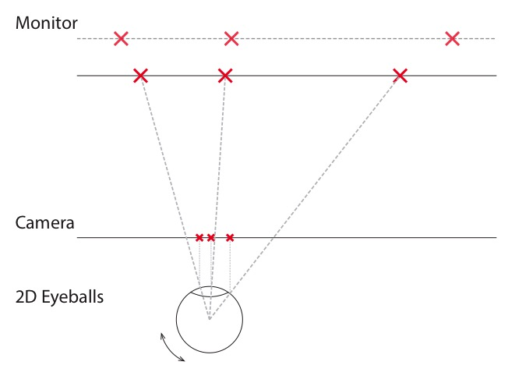
Can eye rays be modeled as straight lines?
Target position
Eye position
Notes:
This time we move our monitor a bit closer to the observer and find another set of targets which correspond to exactly the same pupil positions.

Slide 10
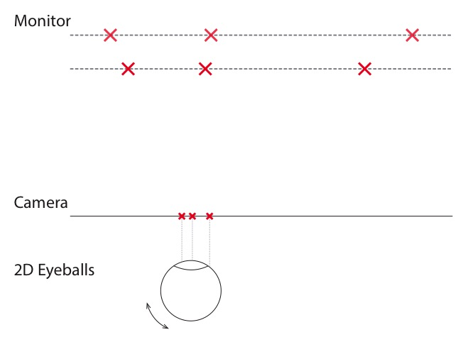
Can eye rays be modeled as straight lines?
Target position
Eye position
Notes:
Luckily we could also find another set when the monitor is moved even closer.
For each set of the correspondences, we can estimate a model to map a pupil position to a position on the screen. And this is exactly what happens in the calibration procedure which is basically where we start each eye tracking experiment.
But no matter which kind of mapping model we use, they are all not concerned with the geometry in the 2d space, namely how those points, that correspond to the same pupil position, are distributed in space.

Slide 11
Can eye rays be modeled as straight lines?
Target position
Eye position
Notes:
Because of the non-linearity of the system, those positions might well lie on a curved line in the 2d space. Just to be clear, we are not questioning that light travels in straight lines in space. But we are rather concerned with the distribution of points that correspond to a fixed pupil position.
There is no way for us to know about the distribution as long as all the targets only lie on the 1d monitor and we would rather need to sample the 2D space.
Same principles apply to the real 3D world. We can of course also move the monitor in space just as what we did, but it doesn’t seem to be that practical.
Therefore, we need better way to do 3d eye tracking, more precisely we need to sample the 3d space and track the corresponding eye positions. Only then we can learn whether eye rays can be modeled as straight lines or not.

Slide 12
Solution: Eye tracking in 3D
Need: pupil positions + positions of stimuli
Visible spectrum: fiducial
Infrared: multi-camera
Synchronization
Notes:
Finally I can introduce our 3d eye tracking setup.
Recap in 2d experiment, we need the corresponding pairs of pupil positions and 2d stimuli positions.
Same two ingredients are needed here, only the stimuli live in a 3d space now.
[CLICK]
As in 2D, video based techniques can still be used to track the pupil positions.
Depending on the light source, 3d stimulus positions can be tracked based on fiducial marker in the visible spectrum, [CLICK]
Or In the infrared range, multi-camera system can sample the space based on triangluation.
Once we have the systems to track both pupil and stimuli positions, the only thing left is to [CLICK] synchronize them and find the right correspondences.

Slide 13
Solution: Eye tracking in 3D
Need: pupil positions + positions of stimulus
Notes:
In our setup, we optioned for multi-camera based system which uses reflective marker.
We sample the 3d space by waving the target and ask the observer to look at it.
In order to compare the viewing behavior in monocular and binocular conditions, we need to occlude the viewing of one eye.
Typical eye patch wouldn’t work because we need to have the same reference frame for all conditions and can’t afford it when observer have to move their head in order to change the eye patch.

Slide 14
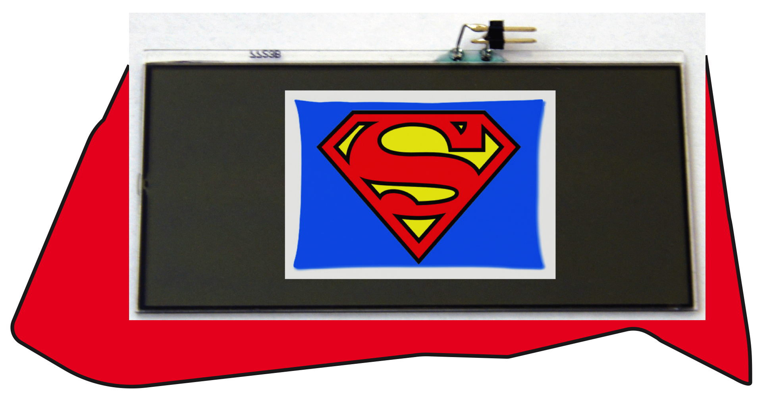
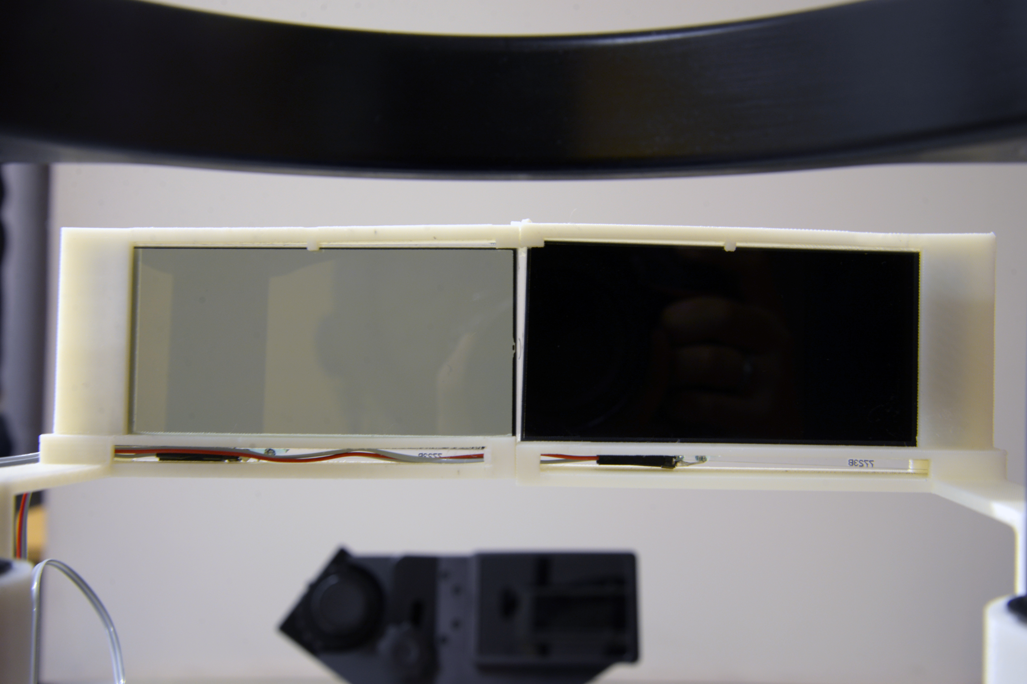
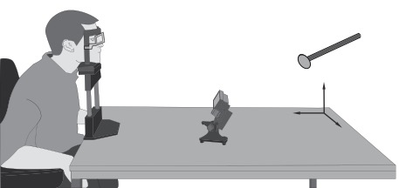
Solution: Eye tracking in 3D
Need: pupil positions + positions of stimulus
Shutter glass
Notes:
Luckily we found our hero, the shutter glass.
It can turn opaque when charged with a small voltage and can be easily programmed to switch between transparent and opaque modes. We put two separate shutter glasses in front of the eyes and
[CLICK]
this is how it looks like when the viewing of the right eye is blocked.

Slide 15
Pilot Study
Monocular calibration: left and right (2 rounds)
Monocular validation: left and right (2 rounds)
Binocular viewing (1 round)
Monocular validation: left and right (2 rounds)
Notes:
Using the proposed 3d eye tracking setup, we conducted a pilot study and make the first attempt to learn the geometric model of 3d eye tracking.
In a standard 2d experimental protocol, we start with calibration by collecting some corresponding point pairs and estimate the mapping. Then we check the calibration accuracy by displaying the targets at the same positions on screen, which is called validation. Once the calibration is good enough we can start the real experiment. After certain amount of time we might want to check the calibration quality again. If it gets too bad, we need to repeat the whole calibration procedure.
So far so good.
We basically followed this in out experiment and have 7 trials in one session, starting with two rounds of monocular calibration, one for each eye, followed by two rounds of monocular validation. After that, observers can view the target using both eyes. Each session ends with another two rounds of monocular validation just to control the quality of collected data.
In each round we collect samples for 15 seconds by waving the marker in space.

Slide 16
Preliminary Results
Notes:
Three observers joined our pilot study and by coincidence they all have right dominant eye.
Before we look at the results, let’s step back and think what we would expect. Probably the calibration accuracy goes down overtime and there is no good reason to expect any differences between the two eyes.
Is that correct?
Let’s start with the dominant eye. We see it looks pretty much like what we expected that the performance gradually gets worse but there is no big differences. But interesting things pop out in the result of the non-dominant eye. Calibration still works quite well and achieves an accuracy of .5 degree of visual angle, but the performance in binocular viewing condition is decidedly worse than either the previous validation or the one after it.
This indicates that we might have different viewing behavior between monocular and binocular conditions, at least this seems to be the case for the tested three observers.

Slide 17
Conclusion / Outlook
3D eye tracking setup
Map 3D point in space to eye orientation/pupil position
Practical problems
Interference
Outliers & Noise
Indicate difference between monocular and binocular viewing
Need more data
Notes:
To summarize the talk, we introduced a new setup for 3d eye tracking in which 3d points can be mapped to pupil positions.
There are also some practical problems in the setup.
Since both tracking systems are based on infrared cameras, they are interfering each other. The lighting condition of room also interferes the tracking as most light sources contain certain amount of infrared light.
Besides this, it is also unavoidable to have outliers and noise in the gathered data for example caused by blinks.
The results of our pilot study indicate a difference between monocular and binocular viewing behavior. However, if our eye rays are not exactly straight lines in space, they wont be terribly far away from that. The deviation of the curves won’t be high.
Besides this, it’s hard to conclude anything else with this less data, especially when we don’t know what is inlier and what is outlier.
Right now we are working on further improving the tracking accuracy and reliability, and will also collect more data and continue with the analysis.

Slide 18


3D Eye Tracking in Monocular and Binocular Conditions
Marianne Maertens
Marc Alexa
Modelling of Cognitive
Processes, TU Berlin
Computer Graphics,
TU Berlin
xi.wang@tu-berlin.de
Thanks for your attention!
Notes:
I just learned that it seems to be a tradition here to thank the co-authors at the end of the talk. So I would also like to take this opportunity to thank the other two contributors of this work who in this case are both my bosses.
You see we are small in numbers, if you have any idea or suggestion, please let us know. And thanks for your attention.

Slide 20
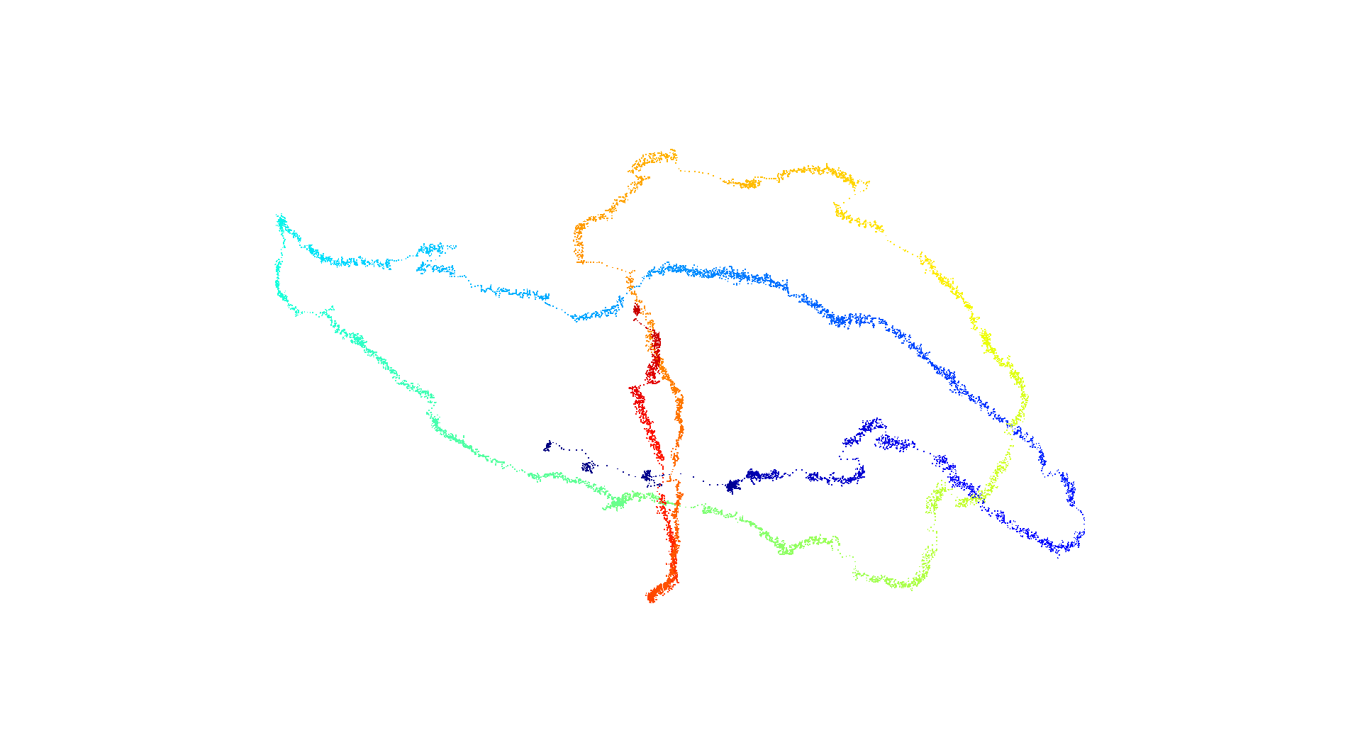
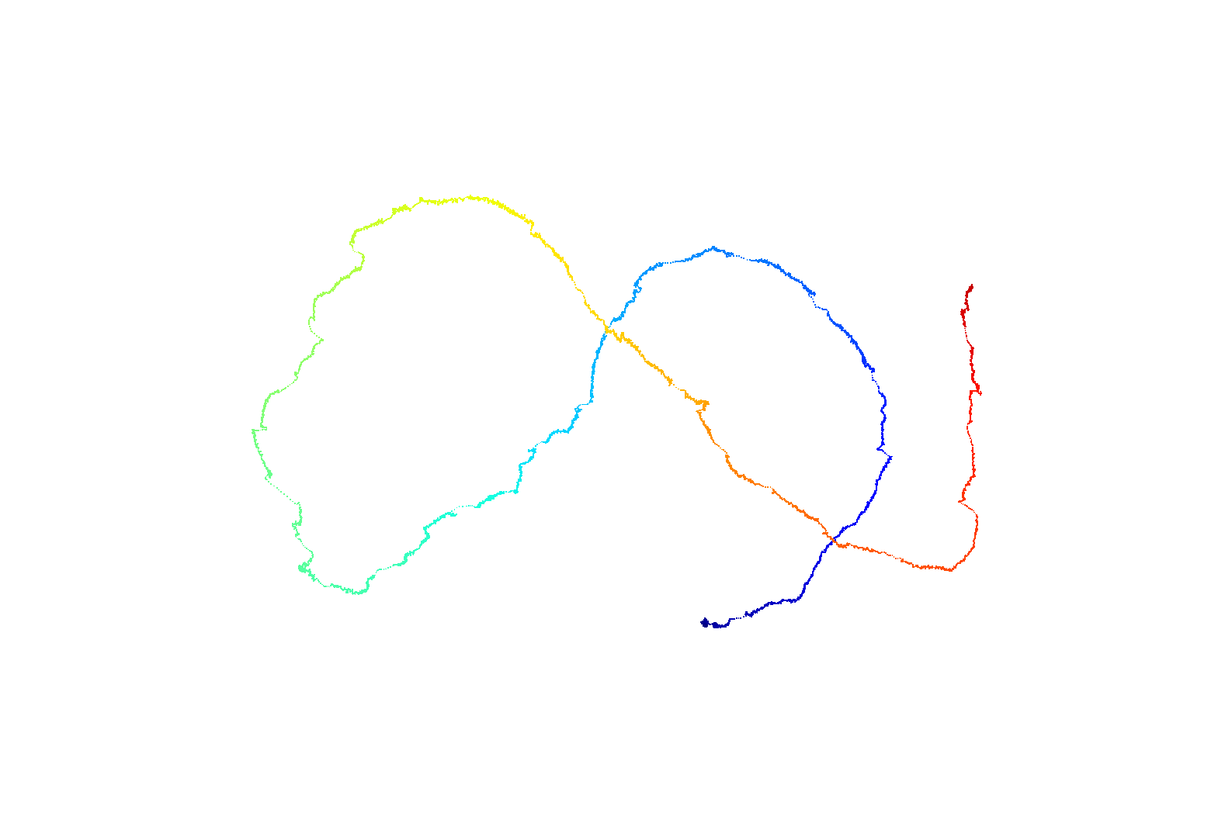
Interference of room light

Slide 21
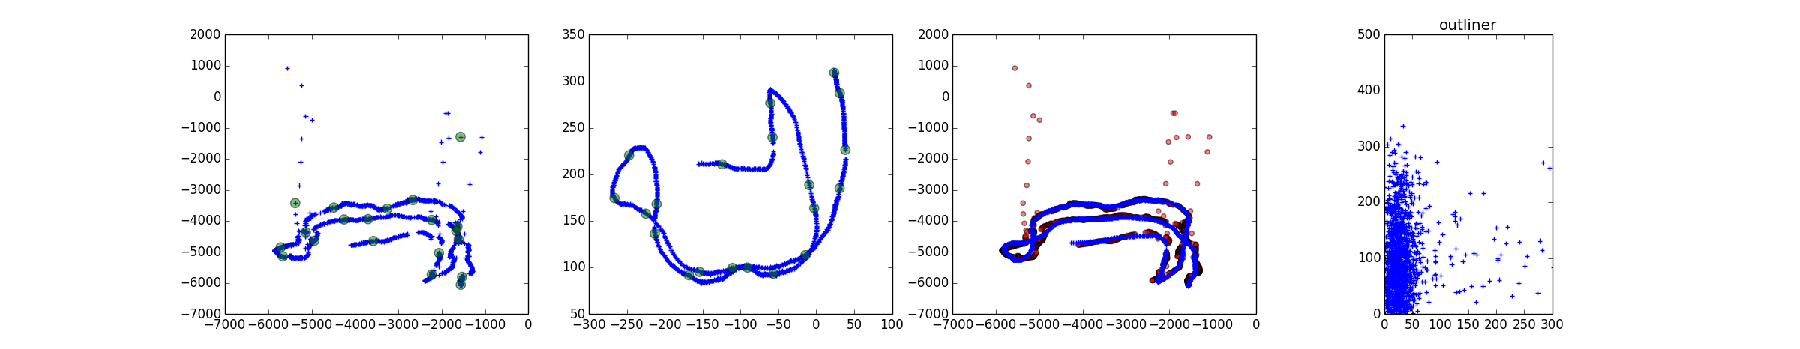
Noise in the data
1° dov
~ 8.8% outliers
132 point pairs out of 1500

Slide 22
2D Replication

Slide 23
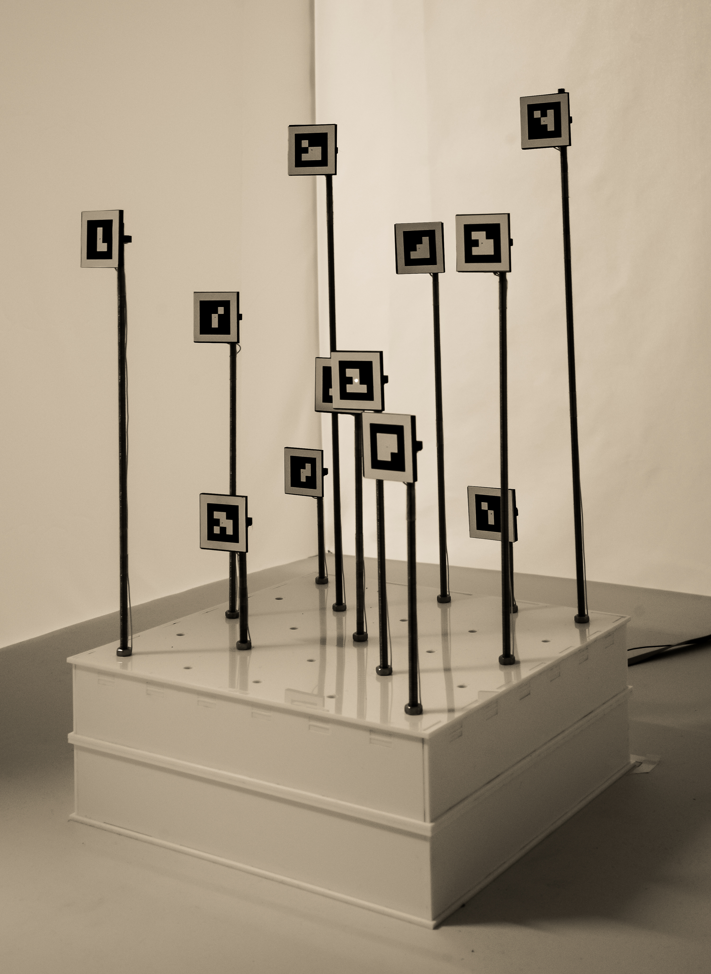
Calibration rig based on fiducial markers

Slide 24
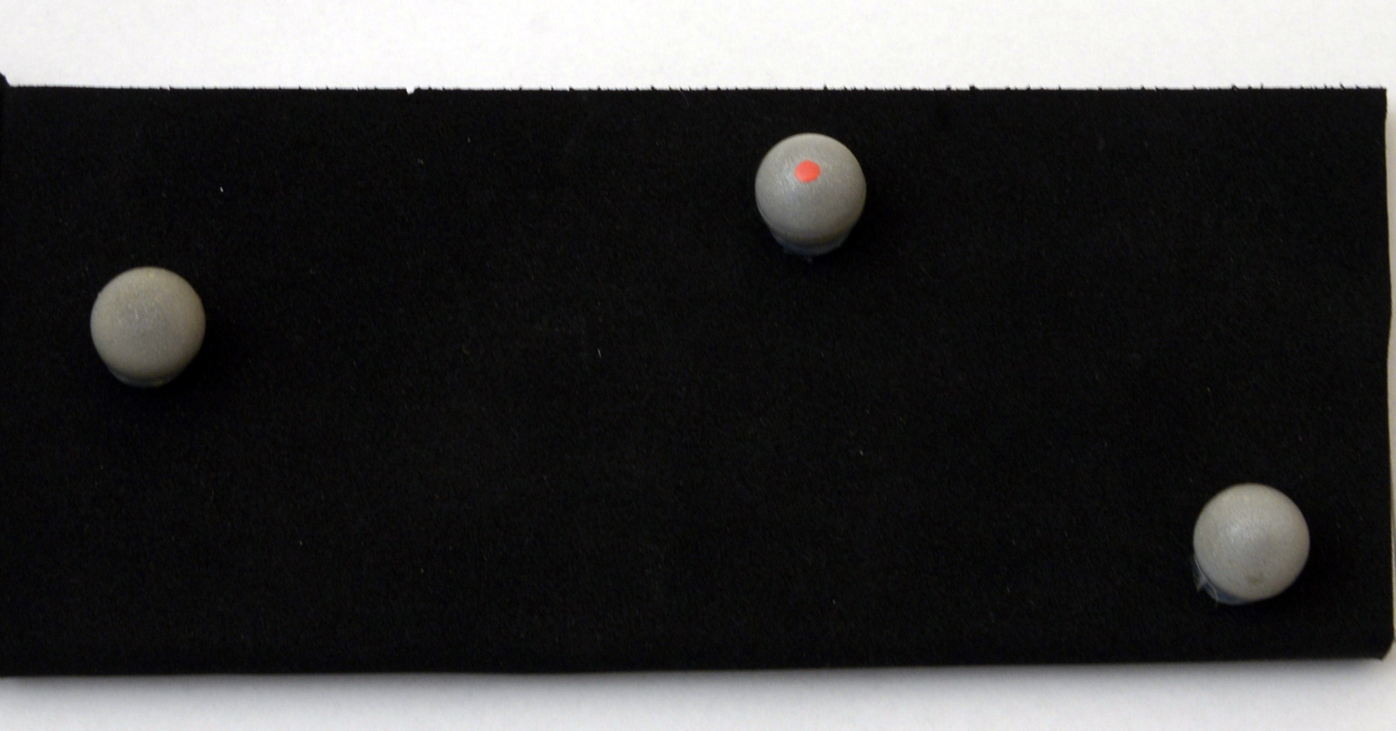
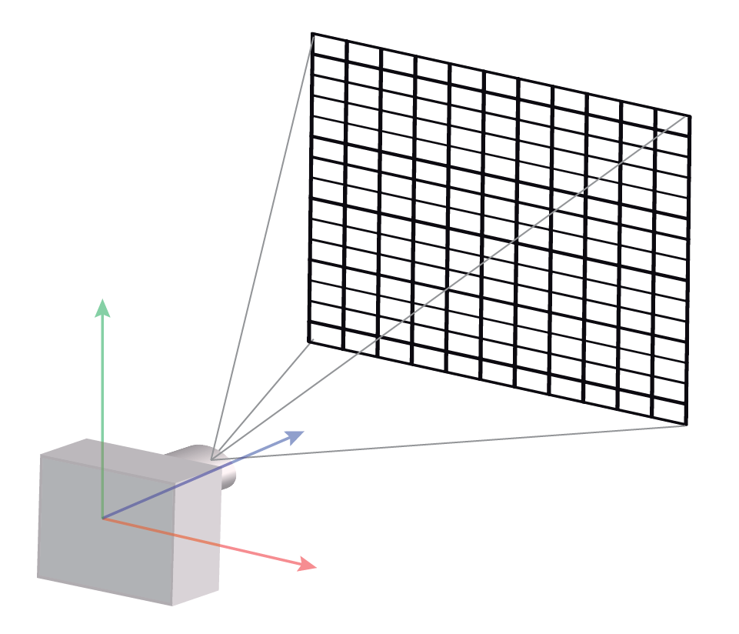
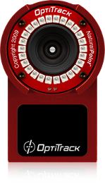
Stimuli tracking in 3D
Fiducial marker
Optitrack
Easy to use
but less accurate
Require calibration
but more accurate

